Slide 1
Data Preprocessing
a Collection of Problems in Data Preprocessing along with Solutions
Qi Lian
2017/2/20

Slide 2
Overview
Introduction to Data Preprocessing
Level-1 Data Preprocessing
Hadoop MapReduce V.S. Spark

Slide 3
Intro to Data Preprocessing:
3-V:
Volume:
Size of datasets
Variety:
Structured, Unstructured
MongoDB, MySQL
Velocity:
Speed at which data generates
Can we trust those datasets?
Can we directly apply those datasets to our algorithms?

Slide 4
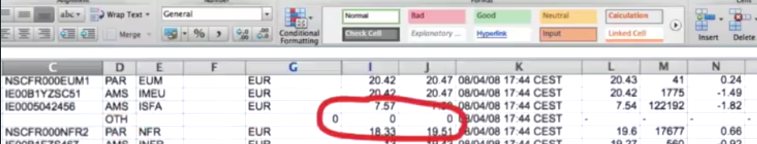

Intro to Data Preprocessing:
Can we trust those datasets?
Can we directly apply those datasets to our algorithms?
Lots of misclassified objects
Tedious execution time

Slide 5
Intro to Data Preprocessing:
Level-1:
Aim:
Maintain clean data in a uniform way in databases
Steps:
Data Cleaning
Data Integration
Level-2:
Aim:
Apply proper datasets to the target algorithms
Steps:
Data Reduction
Data Transformation

Slide 6
Level-1: Data Cleaning
Problem I: Noise points
Behavior:
Class noise: misclassification & conflict class labels
Attribute noise: attributes that influence the classification preformance
Solution:
Noise Filters
Robust Strategies (usually based on Machine Learning algorithms)

Slide 7
Level-1: Data Cleaning - Noise Filters
Solution 1: Noise Filters (Ensemble Filter)
Intro:
Group original datasets into T subsets
For each subset, run m filter algorithms over other T-1 subsets
Decide the ideal label by consensus vote scheme
Implementation:
KEEL software: http://www.keel.es/
Data Preprocessing functions are embedded in this software.

Slide 8
Level-1: Data Cleaning - Robust Strategies
Solution 2: Robust Strategies
Intro:
Focus on the selection of the algorithms (eg. clustering...)
Not much to deal with the data itself.

Slide 9
Level-1: Data Cleaning
Problem II: Missing Data Fields
Behavior:
Entry A has attribute a, while Entry B doesn't have;
Entry A originally has attribute a, while being eliminated by manual processing/error recording;
Solution:
Omitting
Setting default values (Expectation-Maximization, usually combined with complex Machine Learning algorithms)

Slide 10
Level-1: Data Cleaning - Omitting
Solution 1: Omitting
Intro:
Do nothing special
Just assume they don't exist
Solution:
Listwise Deletion
Delete the whole problematic entry by ignoring other useful fields
Pairwise Deletion
Only delete the problematic field while keeping the useful fields

Slide 11
Level-1: Data Cleaning - Setting Default Values
Solution 2: Imputaion
Intro:
Deletion strategy may fail for small datasets
Get imputed values, kind of guessing
Solution:
Set the mean as default values
Retain the mean, but bad for field relationship
Linear Regression:
Amplify the current trends
Other Robust approaches involved with Machine Learning
Complicated, get first-hand errors before our ML algorithms

Slide 12
Level-1: Data Integration
Problem I: Attributes Redundancy
Behavior:
salary/month => salary/year
Solution:
Chi-Square Correlation Test
Correlation Coefficient and Covariance

Slide 13
Level-1: Data Integration - Chi-Square Correlation Test
Solution 1: Chi-Square Correlation Test
Intro:
Hyposis
Solution:
Construct the contingency table
Apply the test formula:
TBD
Compare with a previously-set significant or confidence level
Reject if xxx

Slide 14
Level-1: Data Integration - Correlation Coefficient and Covariance
Solution 2: Correlation Coefficient and Covariance
Intro:
Similar to Chi-Square Correlation Test
Apply a different statistical formula

Slide 15
Level-1: Data Integration
Problem II: Tuple Duplication and Inconsistency
Behavior:
"id" data field stored as "_id" in MySQL, while "id" in MongoDB
Solution:
Meta-data Comparison
Edit Distance

Slide 16
Level-1: Data Integration - Meta-data Comparison
Solution 1: Meta-data Comparison
Intro:
Meta-data
The data that describes our target data
eg: Type, range, etc.
Solution:
Compare how the meta data of two fields are close to each other

Slide 17
Level-1: Data Integration - Edit Distance
Solution 2: Edit Distance
Intro:
Quantitatively evaluate how one string is close to the other
Solution:
Set the cost for deletion, insertion, replacement
Apply Dynamic Programming to get the target distance
xxxxx (recursive formula)

Slide 18
Data Preprocessing: Level-2
To be covered by Xinyue Ou in the Monday after the next one.

Slide 19
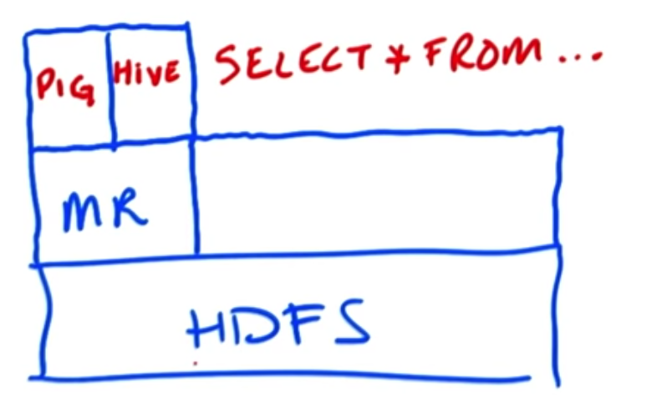
Hadoop MapReduce V.S. Spark
Review for basics of Hadoop
Hard to code raw M/R
PIG
Hive
Hadoop Streaming
General interface
Spark
HBase

Slide 20
Hadoop MapReduce
A computation framework for big data
Mapper:
Reducer:
Shuffle and Sort
Demo on the whiteboard
raw data
Map()
<key, value>
<key, value>
Reduce()
Result

Slide 21
Hadoop MapReduce
Is that Enough for all situations?
Pros:
Process data blocks in parallel (not the same parallel for Qun Song's topic)
Cons:
Fixed workflow
Must have a Mapper and a Reducer
Disk-oriented
Bad for iterative algorithms working on the same datasets

Slide 22
Spark
Another computation framework
RDD (Resilient Distributed Datasets)
Pros:
In-memory process
Good for iterative algorithms, resource reusage
DAG execution engine
More phase combinations
Thread-level parallelism instead of Process-level
Each task is a thread, lighter weight
Cons:
Rely on disks if datasets can't fit in the memory
But still access higher performance than MapReduce
In-memory speed 100:1, overall speed 10:1

Slide 23
Summary
Basic Workflow:
Fetch raw data
Data integration
Data cleaning
Store clean data in HDFS
Fetch level-1 preprocessed data
Data reduction
Data transformation
Run the target algorithm
Store results in HDFS
Python library:
Pandas
Scikit-Learn
PySpark

Slide 24
Reference
Textbook:
Data Preprocessing in Data Mining, Springer 2014
Data Mining Concepts and Techniques, 3rd Edition, Jiawei Han
Udacity:
Intro to Hadoop and MapReduce
Data Wrangling with MongoDB
Coursera: Hadoop Platform and Application Framework

Slide 25
END
Thanks!

